Slide 1
CELLS AND LEVEL OF ORGANISATION

Slide 2
The cell: is the basic structural and functional unit of living things.
Main parts of all cells:
cell membrane
cytoplasm
and in most a nucleus.

Slide 3
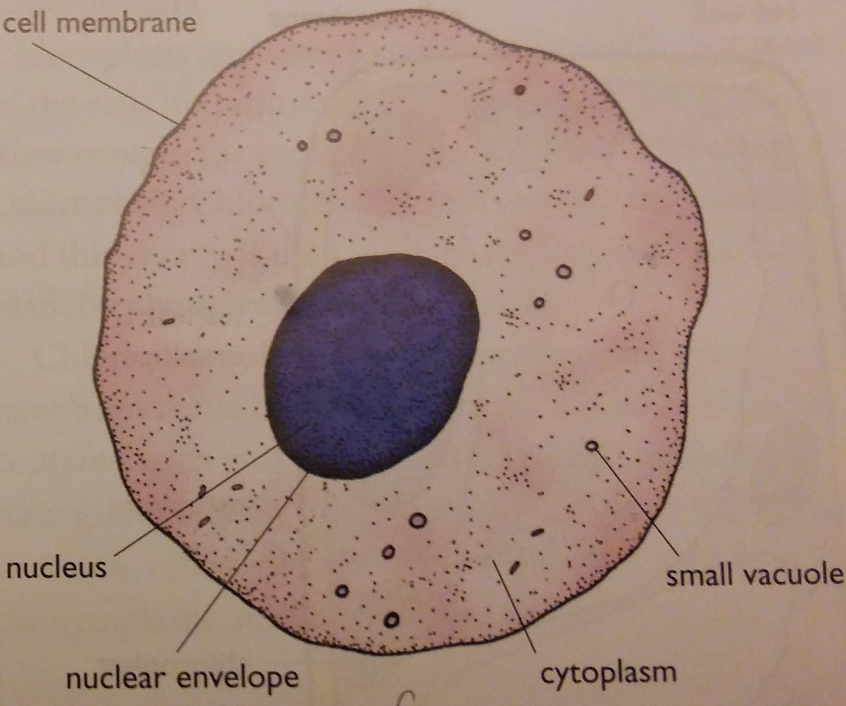
A diagram of a liver cell as seen by a light microscope

Slide 4
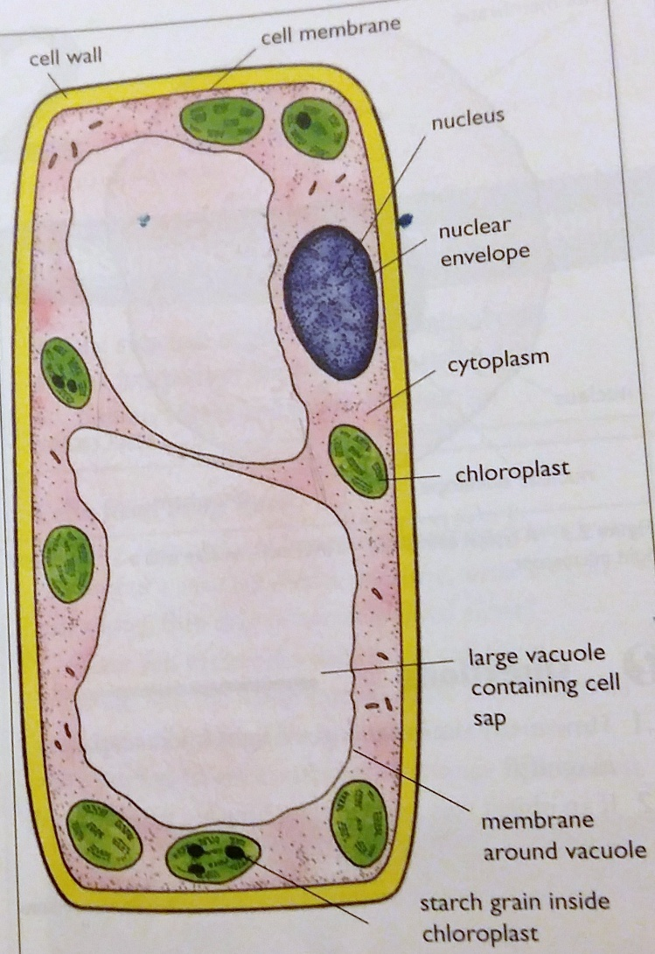
A diagram of a palisade cell as seen by a light microscope:

Slide 5
A comparison between an animal cell (liver cell) and a plant cell (palisade cell):
Plant cells | Animal cells
Have a cellulose cell wall outside the cell membrane | Have no cell wall
Have a cell membrane | Have a cell membrane
Have cytoplasm | Have cytoplasm
Have a nucleus | Have a nucleus
Often have chloroplasts containing chlorophyll | Have no chloroplast
Often have large vacuole containing the cell sap | Have only small vacuoles
Often have starch grains | Never have starch grains; Sometimes have glycogen granules
Often regular in shape | Often irregular in shape

Slide 6
Cell membrane: a thin layer around the outside. It consists mainly of proteins and fats. Function: it controls the entry and exit of substances in and out of the cell. It is a partially permeable membrane.
Cytoplasm: about 70% is water in many cells. It contains many substances dissolved in it. Function: a site where most chemical reactions take place.

Slide 7
Nucleus: a rounded structure enclosed in a porous membrane. It contains the genetic material DNA, which makes up the chromosomes. Function: it controls
cell division
cell type, Ex: red blood cell, whit blood cell, liver cell, nerve cell ….
type and quantity of enzymes, so it controls all cell activities.

Slide 8
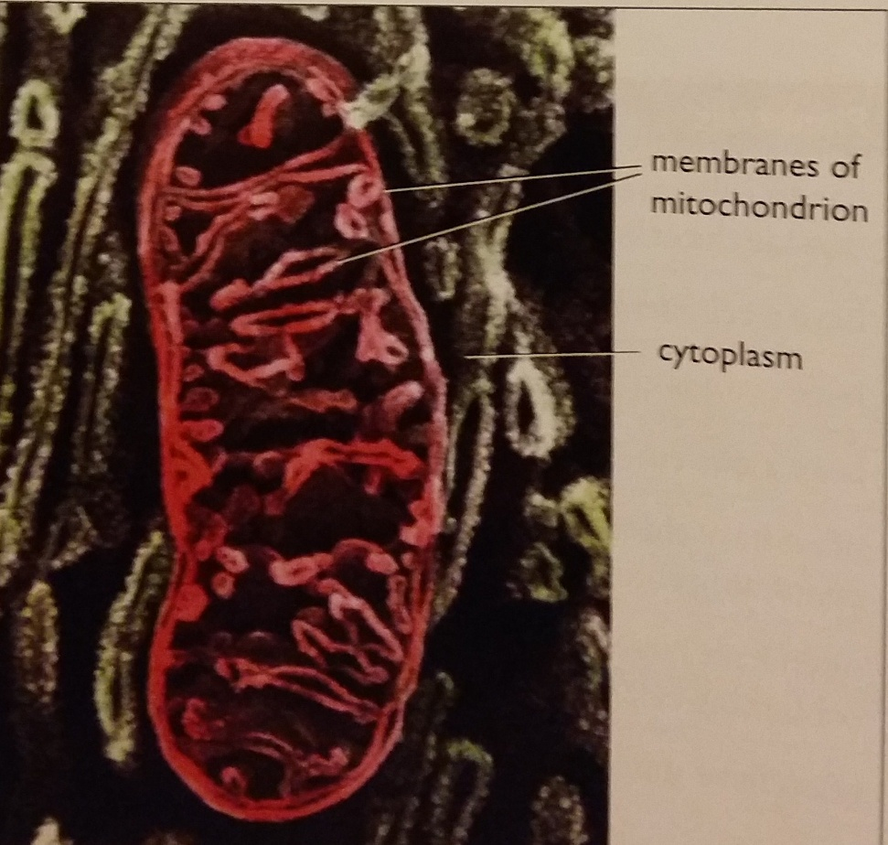
Mitochondria
They are found in almost all cells, except those of prokaryotes. Sometimes referred as the power house. Function
Site of aerobic respiration;
Production of ATP ( to provide cell with energy).

Slide 9
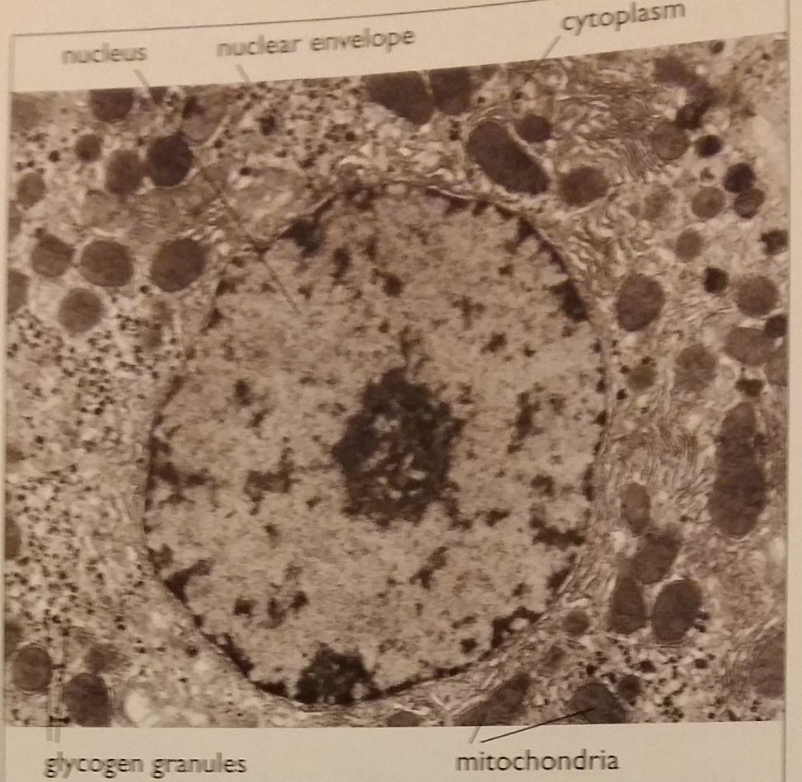
Ribosomes
They are tiny structures which can be seen with an electron microscope;
Ribosomes are found in all cells;
Function:
They are the places where proteins are made, by joining amino acids together in a chain.
This is done according to instructions carried on the DNA in the cells nucleus.
It is the DNA which determines the sequence of protein in a cell.

Slide 10
Ribosomes are found:
Either free in the cytoplasm;
Or on the surface of rough ER;
What is rough ER?
Rough endoplasmic reticulum is a network of membrane, it has ribosomes on its surface;
Function of rough ER
It stores and transports protein.

Slide 11
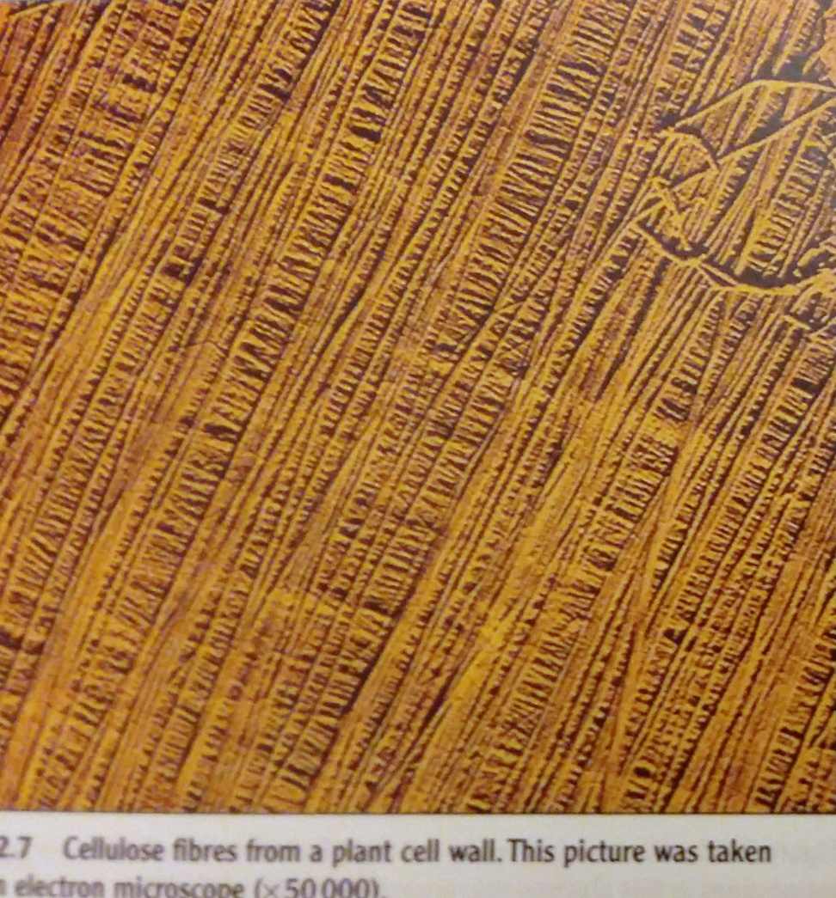
Cell wall:
it lies outside the cell membrane;
it contains cellulose and other substances;
Cellulose form fibers which criss-cross over one another to form a very strong covering to the cell;
it is non-living and freely (fully) permeable to water and dissolved substances.
Function: the cell wall provides structural support and protects against damage caused by osmotic intake of water.

Slide 12
Vacuoles
A Vacuole is a space in a plant cell, surrounded by a membrane. It contains the cell sap, a watery solution of sugars, salts and pigments.
Note: Animal cells have much smaller vacuoles called vesicles, which may contain food or water.

Slide 13
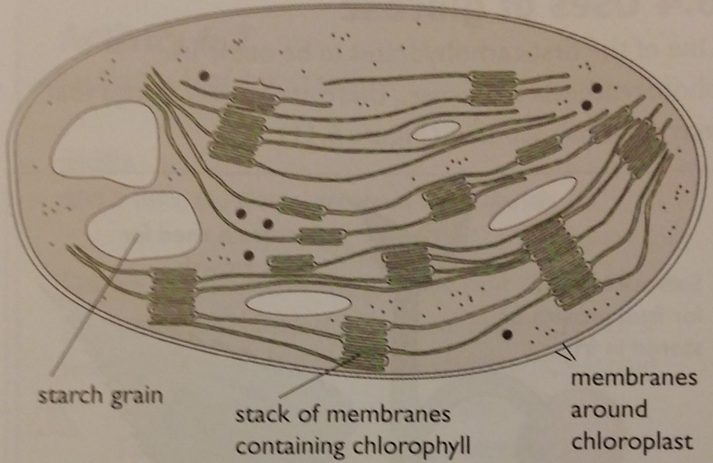
Chloroplasts
Chloroplasts are found in the cells in the green parts of plants.
They are organelles which contain the green substance chlorophyll (for light absorption ) and the enzymes necessary for the production of glucose by photosynthesis.
Chloroplasts often contain starch grains, starch is made of many glucose molecules.
Animal cells do have granules (tiny grains) of another substance similar to starch, called glycogen;
Glycogen granules are found in the cytoplasm.

Slide 14
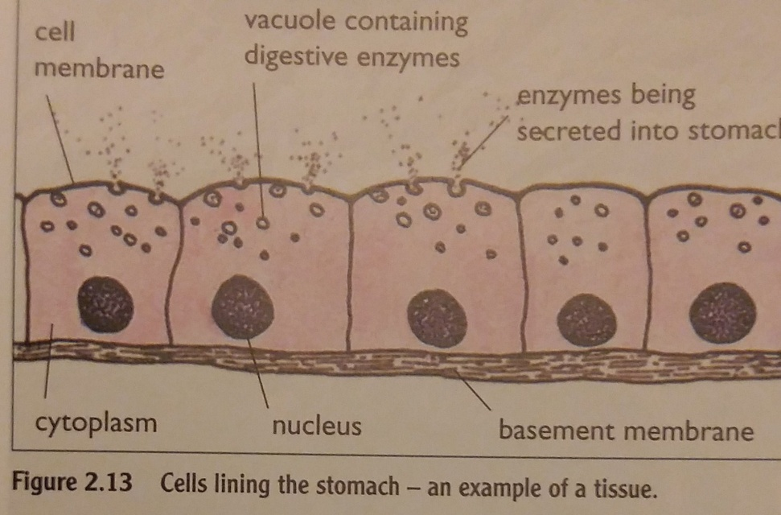
Level of organization
Cell → Tissue → Organ → Organ system → Organism. Tissues: group of cells with similar structure and function (Cells specialized in the same activity).
Examples:
Epithelial tissue, such as the cells lining the stomach;
Muscle tissue;
Epidermis in plants;
Palisade tissue, a layer of cells inside a leaf which are specialized to carry out photosynthesis.

Slide 15
Organs: consist of several tissues grouped together to make a structure with a special function. e.g. stomach, heart, lungs, eyes, brain, intestine, root, stem and leaves.
Organ System: group of organs, whose functions are closely related. e.g. Heart and blood vessels make up the circulatory system. Brain, spinal cord and nerves make the nervous system. Stem, leaves and buds make up a shoot system.
Organism: formed by organs and systems working together to produce an independent plant/animal.

Slide 16
Cell specialization
A specialized cell is a cell which has lost its ability to divide. It develops a distinct shape and becomes adapted to do one particular job.

Slide 17
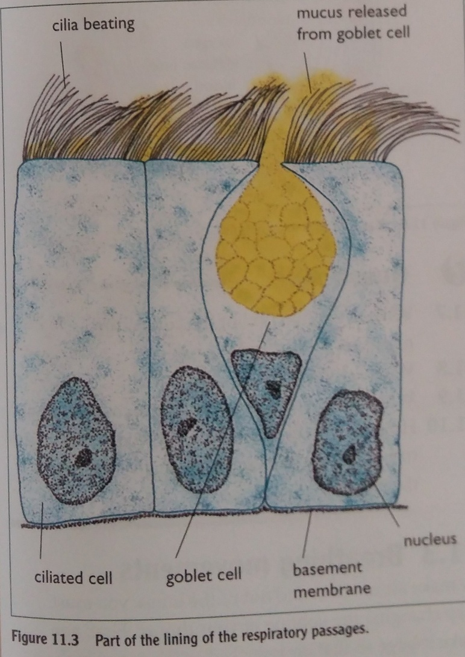
Ciliated cells

Slide 18
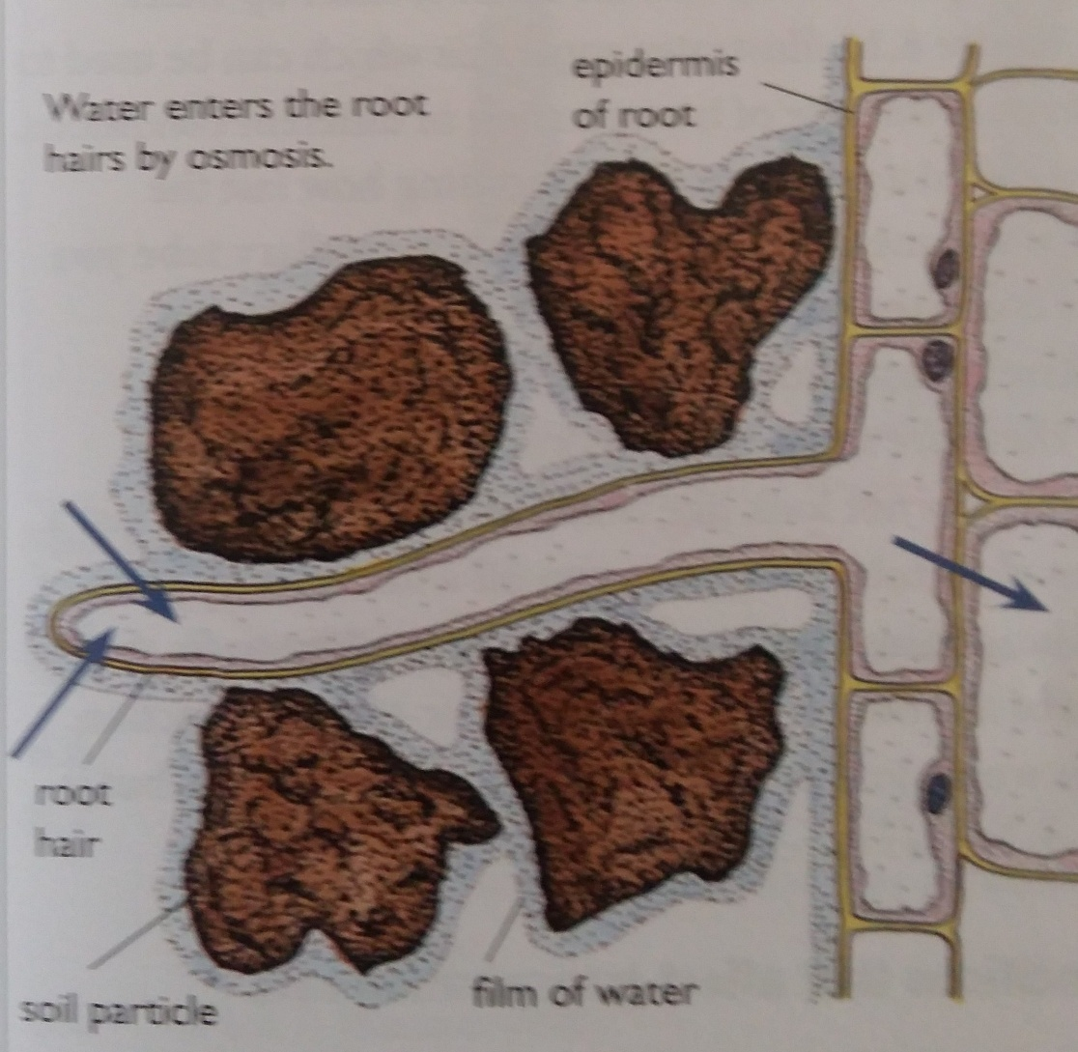
Root hair cell

Slide 19
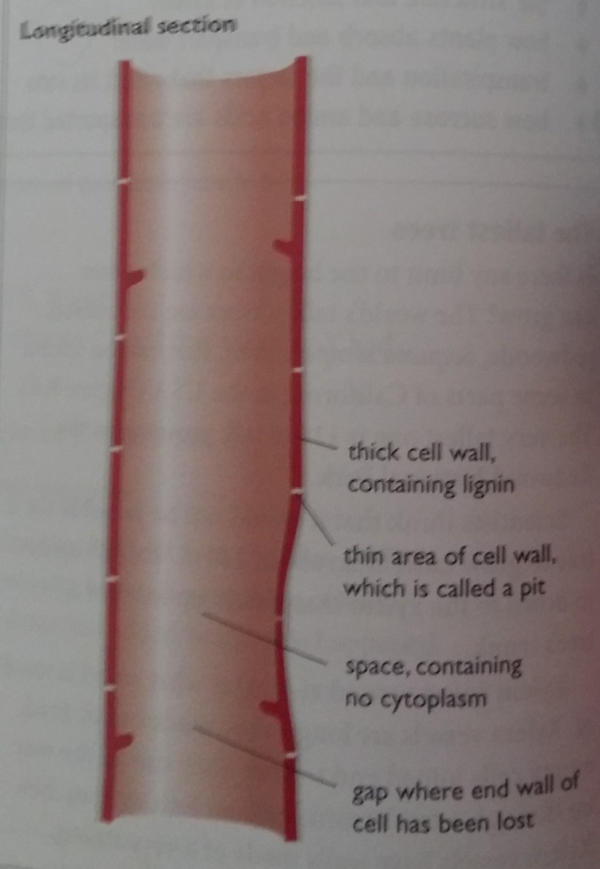
Xylem vessel

Slide 20
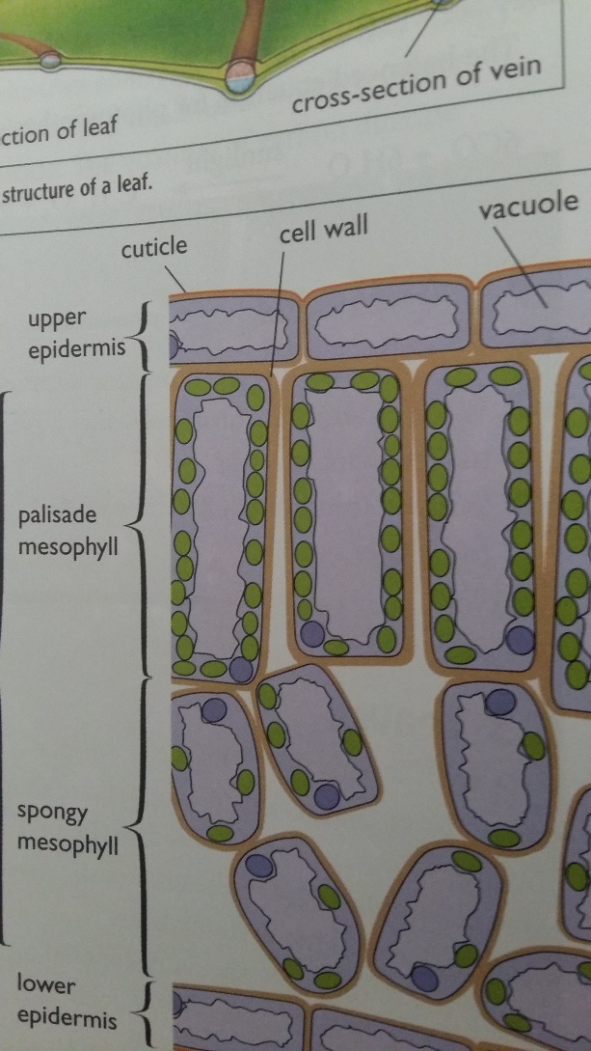
Palisade cell

Slide 21
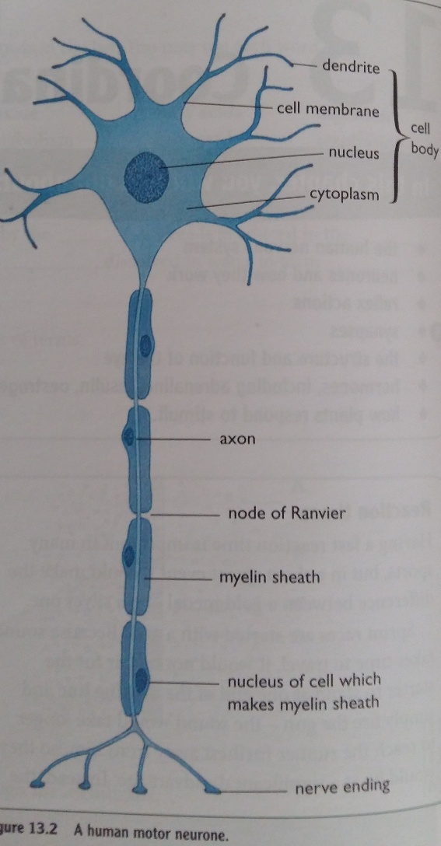
Nerve cell

Slide 22
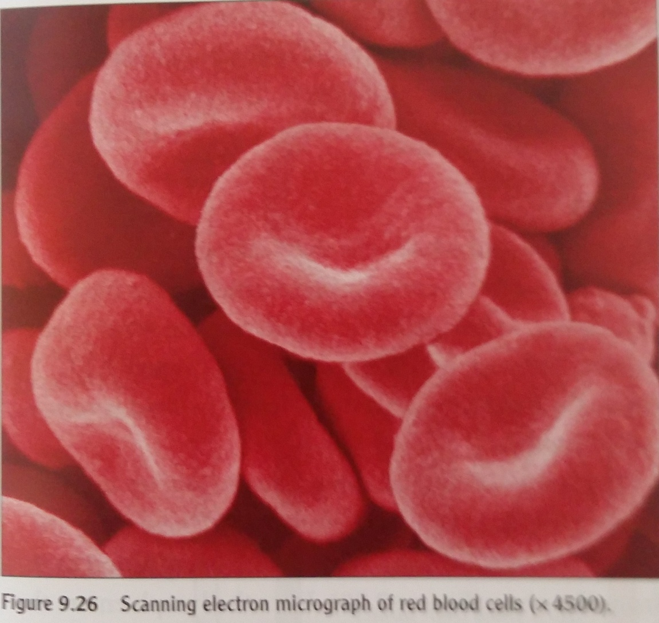
Red blood cells

Slide 23
Type of cell | Where is it found? | Function | Adaptation
Ciliated cells | Lining of trachea and bronchi | Move mucus upwards | Have cilia that vibrate to move mucus
Root hair cells | Near the ends of plant roots | Absorb water and mineral salts | The cell has long extension (a root hair) which increases the surface area for the absorption of materials;
Xylem vessels | In stems, roots and leaves of plants | Transport water and mineral salts; | The cell has no cytoplasm so water can pass freely; No end wall so that many cells form a continuous tube; Walls are strengthened with a waterproof substance called lignin (prevent collapsing);
Palisade cells | Beneath the epidermis of a leaf | photosynthesis | Have a large number of chloroplasts to absorb the maximum amount of light;
Nerve cells | Throughout the bodies of animals | Transmit information in the form of electrical impulses | The cell has a long fiber along which impulses travel; The fiber is covered by a fatty sheath which gives electrical insulation and speeds up conduction of impulses; The cell has many branched ending which connect with many other cells;
Red blood cells | In the blood of mammals | Transport oxygen | The cytoplasm is filled with the pigment hemoglobin which carry oxygen ; The cell has no nucleus, leaving more space for hemoglobin; RBCS are flexible, they can be forced through even narrowest blood vessels; A RBC has a biconcave disc-like shape which increases the surface area for more oxygen gas absorption;
Sperm and egg cells | In the testes and ovaries | Fuse together to produce a zygote | Page 214

